Slide 1
High Demand & Low Supply: A Snapshot of DC Housing
Presenters: Mulugeta Enyew, Ryan Williams, & Abel Habte
June 5, 2023

Slide 2
Overview
What’s the Problem?
Housing in DC remains one of the District’s most challenging social issues to fix
Fixed land area, skyrocketing prices, and increasing population are all exacerbating factors for this problem
Dataset
Publicly available CSV on DC Residential Properties updated through July 2018
Dataset designed using data from Open Data DC database

Slide 3
Research Questions
Research Question 1
What are the primary characteristics of the DC housing market?
Research Question 2
How do housing conditions and quality differ by geography?
Research Question 3
What are the primary factors driving housing costs in the District?

Slide 4
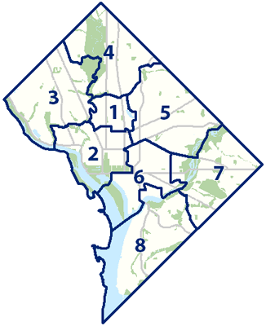
Primary Characteristics of DC Housing

Slide 5
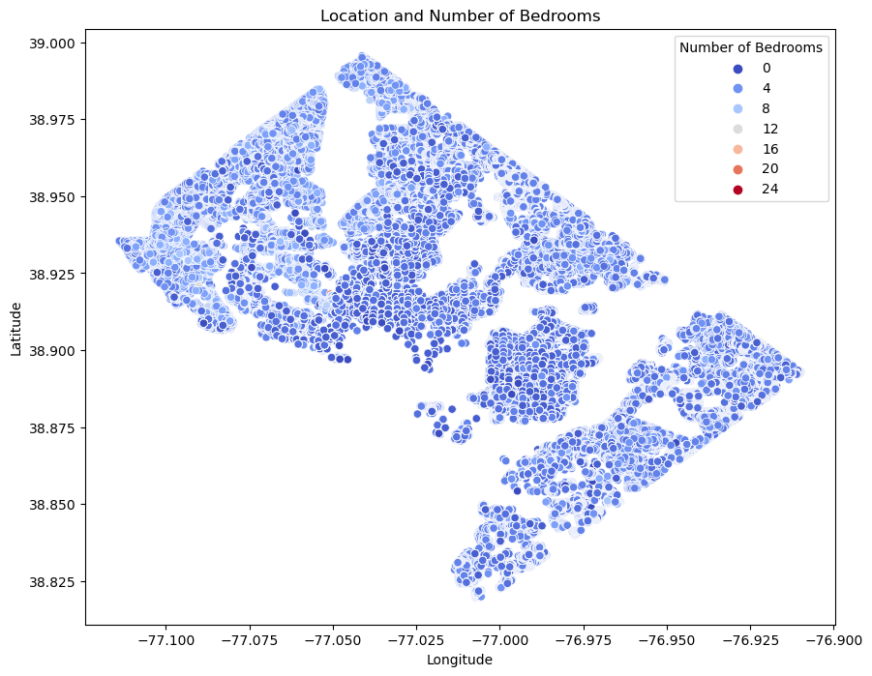
Findings
Average # of bedrooms: 2.73
Average # of bathrooms: 1.8
Age of the average DC residential property is 78 years old.
The oldest residential building was constructed in 1754.
Average lifespan of a home in the US is 75 - 100 years old.*
*Reference: https://www.nyrentownsell.com/blog/lifespan-of-a-house/#:~:text=The%20average%20life%20span%20of,last%20more%20than%2020%20years.

Slide 6
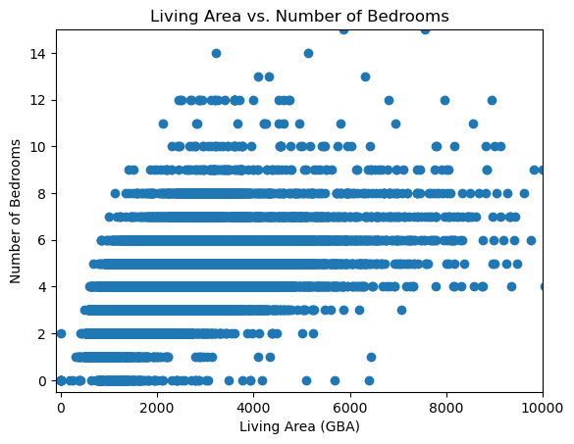
Findings
Average square footage is 1,714
Distribution of homes by living space has a heavy positive skew
Many 5 or 6 bedroom homes have less than 2000 square feet
Average home price is $931,351
Distribution of home prices are as follows:
25th percentile: $240k
50th percentile: $399k
75th percentile: $652k

Slide 7
Housing Conditions by Geography

Slide 8
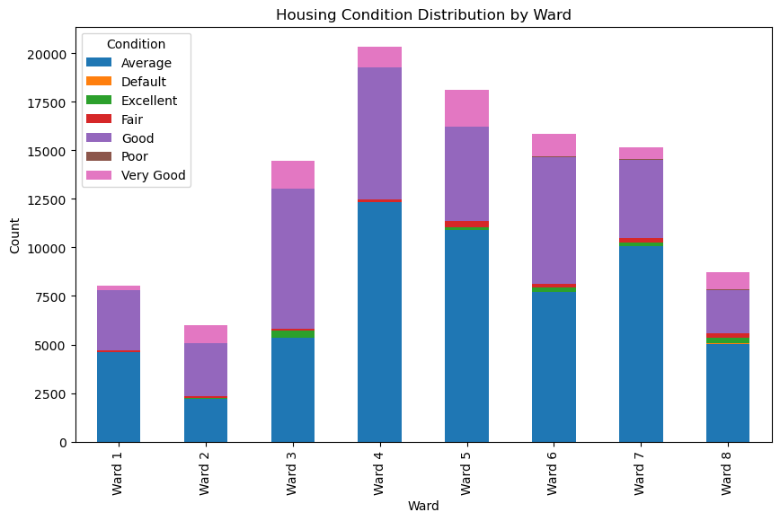
Findings
Proportionally speaking, more affluent wards in DC enjoy better housing conditions
Wards 7 & 8 have a significantly higher proportion of homes sold in “average” condition and a lower proportion of “good” or “very good” homes
The inverse is true for Wards 2 & 3

Slide 9
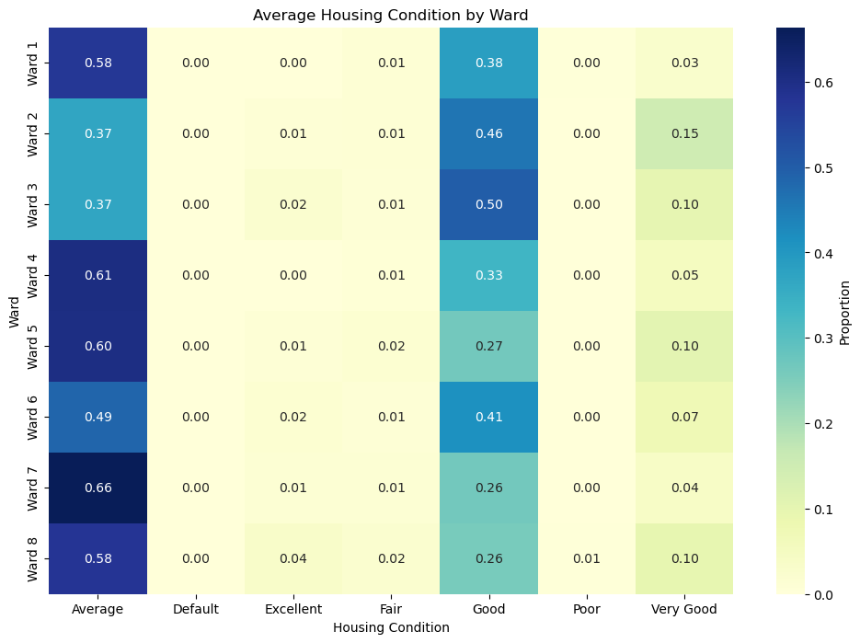

Slide 10
Primary Drivers of Home Price

Slide 11
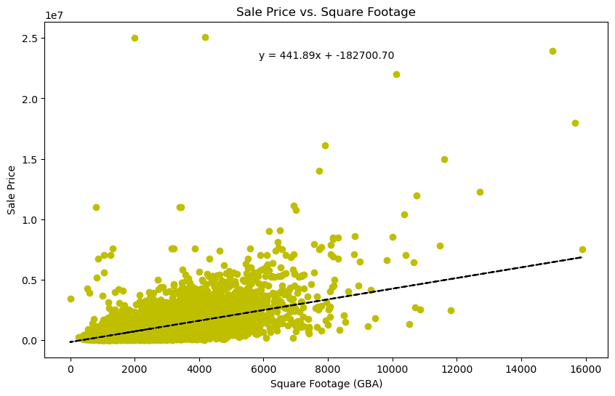
Findings
Positive correlation between living area in sq ft and home price
For every 100 square feet of available living space on a property, home price is expected to increase by $4,418.

Slide 12
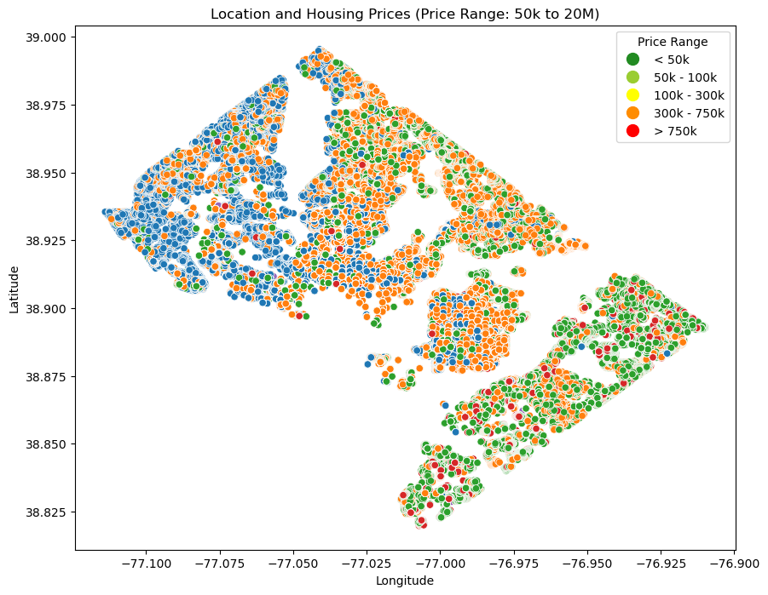
Findings
Buyers more willing to pay more to live in central areas of city
Disparity in property value between Wards 7 & 8 (lower right) and the rest of DC starkly visible.
Note: Blue points indicate homes sold with no sale price data available.

Slide 13
Limitations
Time/Recency
Dataset reflects data up to July 2018
Notable events which may have exacerbated outdated nature of data:
COVID-19 pandemic
Large scale economic recession
Significant regional events (i.e arrival of Amazon headquarters)
Source of Data
Incongruent data (missing values, skewed distribution) complicates findings
Implications on our Study:
Unrealistic representation of DC housing conditions (virtually zero homes in data set in “poor” condition
Significantly higher home prices

Slide 14
Questions?

